Slide 1
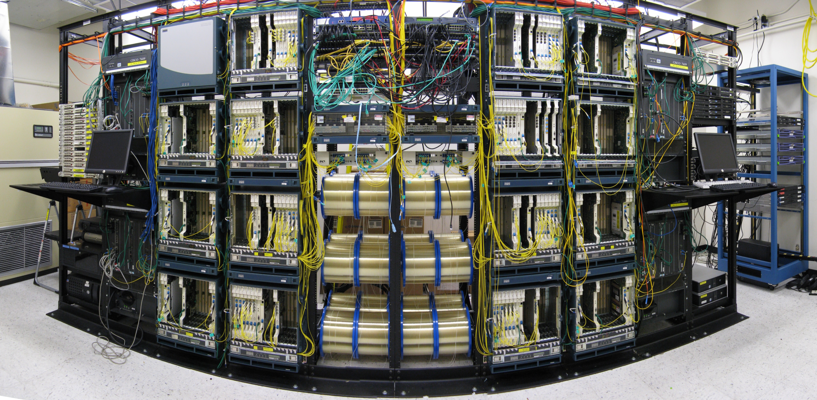
Congestion Control & Optimization
Steven Low
netlab.CALTECH.edu
Cambridge 2011

Slide 2
Acknowledgments
Caltech: L. Chen, J. Doyle, C. Jin, G. Lee, H. Newman, A. Tang, D. Wei, B. Wydrowski, Netlab Gen1
Uruguay: F. Paganini
Swinburne: L. Andrew
Princeton: M. Chiang

Slide 3
Goal of tutorial
Top-down summary of congestion control on Internet
Introduction to mathematical models of congestion control
Illustration of theory-guided CC algorithm design

Slide 4
Theory-guided design
Tight integration of theory, design, experiment
Analysis done at design time, not after
Theory does not replace intuitions or heuristics
Refines, validates/invalidates them
Theory provides structure and clarity
Guides design
Suggests ideas and experiments
Explores boundaries that are hard to experiment

Slide 5
Theory-guided design
Integration of theory, design, experiment can be very powerful
Each needs the other
Combination much more than sum
Tremendous progress in the last decade
Not as impossible as most feared
Very difficult; but worth the effort
Most critical: mindset
How to push theory-guided design approach further ?
Notes:
After FR/FR, when CA is entered, cwnd is half of the window when lost was detected.
So the effect of lost is halving the window.
[Source: RFC 2581, Fall & Floyd, “Simulation based Comparison of Tahoe, Reno, and SACK TCP”]

Slide 6
Agenda
9:00 Congestion control protocols
10:00 break
10:15 Mathematical models
11:15 break
11:30 Advanced topics
12:30 lunch

Slide 7
Audience background
Know TCP/IP protocols?
Know congestion control?
Experiment with ns2? Linux kernel?
Know optimization theory? Control theory?
Know network utility maximization?

Slide 8
Congestion Control Protocols

Slide 9
Congestion control protocols
Why congestion control?
Where is CC implemented?
Window control mechanism
CC protocols and basic structure
Active queue management (AQM)

Slide 10
Congestion collapse
October 1986, the first congestion collapse on the Internet was detected
Link between UC Berkeley and LBL
400 yards, 3 hops, 32 Kbps
throughput dropped to 40 bps
factor of ~1000 drop!
1988, Van Jacobson proposed TCP congestion control
WHY ?
throughput
load

Slide 11
Network milestones
1969
1974
81
83
1988
1991
1996
1999
2003
2006
ARPANet
TCP/IP
TCP
Cutover
to TCP/IP
Tahoe
HTTP
Backbone speed:
50-56kbps, ARPANet
T1
NSFNet
T3, NSFNet
OC12
MCI
OC48
vBNS
Network is exploding
OC192
Abilene
Notes:
HEP = High Energy Physics – most recent demonstration was a few weeks ago where the team achieved a peak through put of 151 Gpbs and sustained through put of over 100 Gpbs

Slide 12
Application milestones
1971
1973
1969
1969
1972
81
83
1988
1988
1993
1995
1990
2004
2005
ARPANet
TCP/IP
Internet
Talk
Radio
Napster
music
iTunes
video
ARPANet
Network
Mail
TCP
Cutover
to TCP/IP
Tahoe
HTTP
Tahoe
Internet
Phone
AT&T
VoIP
50-56kbps, ARPANet
Whitehouse
online
YouTube
T1
NSFNet
Telnet
T3, NSFNet
OC12
MCI
File
Transfer
OC48
vBNS
Simple applications
OC192
Abilene
Diverse & demanding applications
Notes:
HEP = High Energy Physics – most recent demonstration was a few weeks ago where the team achieved a peak through put of 151 Gpbs and sustained through put of over 100 Gpbs

Slide 13
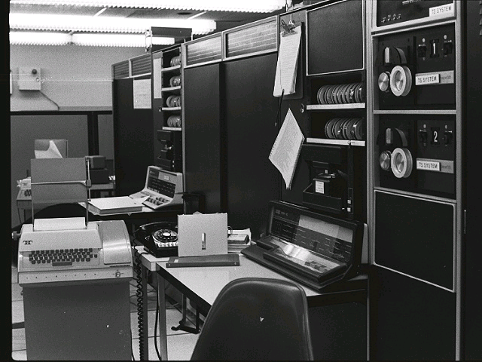
Network Mail (1971)
First Internet (ARPANet) application
The first network email was sent by Ray Tomlinson between these two
computers at BBN that are connected by the ARPANet.

Slide 14






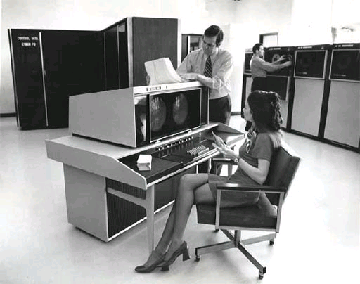


Internet applications (2006)
Telephony
Music
TV & home theatre
Finding your way
Mail
Friends
Library at your finger tip
Games
Cloud computing

Slide 15
Congestion collapse
1969
1969
1969
1974
81
1983
83
1988
1988
1988
1993
1995
1990
2004
2006
TCP/IP
ARPANet
TCP/IP
Internet
Talk
Radio
Napster
music
iTunes
video
ARPANet
ARPANet
TCP
Cutover
to TCP/IP
HTTP
Network
Mail
TCP
Tahoe
Tahoe
Internet
Phone
AT&T
VoIP
50-56kbps, ARPANet
Whitehouse
online
YouTube
T1
NSFNet
Telnet
congestion collapse
detected at LBL
T3, NSFNet
OC12
MCI
File
Transfer
OC48
vBNS
OC192
Abilene
Notes:
HEP = High Energy Physics – most recent demonstration was a few weeks ago where the team achieved a peak through put of 151 Gpbs and sustained through put of over 100 Gpbs

Slide 16
Congestion collapse
October 1986, the first congestion collapse on the Internet was detected
Link between UC Berkeley and LBL
400 yards, 3 hops, 32 Kbps
throughput dropped to 40 bps
factor of ~1000 drop!
1988, Van Jacobson proposed TCP congestion control
throughput
load

Slide 17
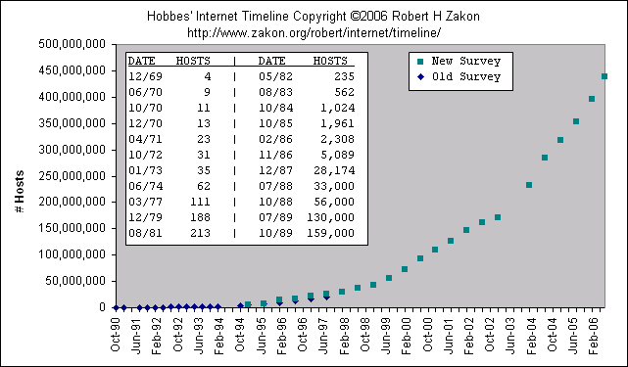
Why the 1986 collapse
congestion collapse
detected at LBL

Slide 18
Why the 1986 collapse
5,089 hosts on Internet (Nov 1986)
Backbone speed: 50 – 56 kbps
Control mechanism focused only on receiver congestion, not network congestion
Large number of hosts sharing a slow (and small) network
Network became the bottleneck, as opposed to receivers
But TCP flow control only prevented overwhelming receivers
Jacobson introduced feedback control to
deal with network congestion in 1988

Slide 19
Tahoe and its variants (1988)
Jacobson, Sigcomm 1988
+ Avoid overwhelming network
+ Window control mechanisms
Dynamically adjust sender window based on congestion (as well as receiver window)
Loss-based AIMD
Based on idea of Chiu, Jain, Ramakrishnan
“… important considering that TCP spans a range from 800 Mbps Cray channels to 1200 bps packet radio links”
-- Jacobson, 1988

Slide 20
TCP congestion control
1969
1969
1969
1974
81
1983
83
1988
1988
1988
1993
1995
1990
2004
2006
TCP/IP
ARPANet
TCP/IP
Internet
Talk
Radio
Napster
music
iTunes
video
ARPANet
ARPANet
TCP
Cutover
to TCP/IP
HTTP
Network
Mail
TCP
Tahoe
Tahoe
Tahoe
Internet
Phone
AT&T
VoIP
50-56kbps, ARPANet
Whitehouse
online
YouTube
T1
NSFNet
Telnet
congestion collapse
detected at LBL
T3, NSFNet
Flow control:
Prevent overwhelming receiver
OC12
MCI
File
Transfer
OC48
vBNS
+ Congestion control:
Prevent overwhelming network
OC192
Abilene
Notes:
HEP = High Energy Physics – most recent demonstration was a few weeks ago where the team achieved a peak through put of 151 Gpbs and sustained through put of over 100 Gpbs

Slide 21
Transport milestones
1969
1974
1983
1988
‘94
‘96
‘98
‘00
2006
ARPANet
TCP/IP
TCP
Tahoe
DECNet
AIMD
Vegas
delay
based
NUM
systematic
design
of TCPs
reverse
engr TCP
formula
Notes:
HEP = High Energy Physics – most recent demonstration was a few weeks ago where the team achieved a peak through put of 151 Gpbs and sustained through put of over 100 Gpbs

Slide 22
Congestion control protocols
Why congestion control?
Where is CC implemented?
Window control mechanism
CC protocols and basic structure
Active queue management (AQM)

Slide 23
Packet networks
Packet-switched as opposed to circuit-switched
No dedicated resources
Simple & robust: states in packets
More efficient sharing of resources
Multiplexing gain
Less guarantee on performance
Best effort

Slide 24
Network mechanisms
Transmit bits across a link
encoding/decoding, mod/dem, synchronization
Medium access
who transmits when for how long
Routing
choose path from source to destination
Loss recovery
recover packet loss due to congestion, error, interference
Flow/congestion control
efficient use of bandwidth/buffer without overwhelming receiver/network

Slide 25
Protocol stack
Network mechanisms implemented as protocol stack
Each layer designed separately, evolves asynchronously
application
transport
network
link
physical
Many control mechanisms…
Error control, congestion control (TCP)
Routing (IP)
Medium access control
Coding, transmission, synchronization
Notes:
Network adopts a layered architecture. As a result, protocol stack for network has five layers: application, transport, network, link and physical layers. Each layer is designed separately and usually abstracted as an optimization problem. For example, TCP can be seen as a distributed algorithm to solve utility maximization problem, intradomain routing is to solve minimum cost problem. The main reason to choose a layered structure is to manage the design complexity. This has been justified by the success of communication network.

Slide 26
The Internet hourglass
Applications
Web
Search
Mail
News
Video
Audio
Friends
TCP
IP
Ethernet
802.11
3G/4G
ATM
Optical
Satellite
Bluetooth
Link technologies

Slide 27
IP layer
Routing from source to destination
Distributed computation of routing decisions
Implemented as routing table at each router
Shortest-path (Dijkstra) algorithm within an autonomous system
BGP across autonomous systems
Datagram service
Best effort
Unreliable: lost, error, out-of-order
Simple and robust
Robust against failures
Robust against, and enables, rapid technological evolution above & below IP

Slide 28
TCP layer
End-to-end reliable byte stream
On top of unreliable datagram service
Correct, in-order, without loss or duplication
Connection setup and tear down
3-way handshake
Loss and error recovery
CRC to detect bit error
Sequence number to detect packet loss/duplication
Retransmit packets lost or contain errors
Congestion control
Source-based distributed control

Slide 29
Protocol data format
Applications (e.g. Telnet, HTTP)
TCP
UDP
ICMP
IP
ARP
Link Layer (e.g. Ethernet, ATM)
Physical Layer (e.g. Ethernet, SONET)

Slide 30
Protocol data format
Application Message
MSS
TCP Segment
TCP hdr
TCP data
IP Packet
20 bytes
IP hdr
IP data
Ethernet Frame
20 bytes
Ethernet
Ethernet data
14 bytes
MTU 1500 bytes
4 bytes

Slide 31
IP Header
0 1 2 3
Vers(4)
H len
Type of Service
Total Length (16 bits)
Identification
Flags
Fragment Offset
Time to Live
Protocol (TCP=6)
Header Checksum
Source IP Address
Destination IP Address
Options
Padding
IP data

Slide 32
TCP Header
0 1 2 3
Source Port
Destination Port
Sequence Number (32 bits)
Acknowledgement Number (32 bits)
Data
Offset
URG
ACK
PSH
RST
SYN
FIN
Reserved
Receive Window (16 bits)
Checksum
Urgent Pointer
Options
Padding
TCP data

Slide 33
Congestion control protocols
Why congestion control?
Where is CC implemented?
Window control mechanism
CC protocols and basic structure
Active queue management (AQM)

Slide 34
Window control
RTT
Source
1
2
W
1
2
W
time
data
ACKs
Destination
1
2
W
1
2
W
time
~ W packets per RTT
Lost packet detected by missing ACK
Self-clocking: regulates flow

Slide 35
Source rate
Limit the number of packets in the network to window W
Source rate = bps
If W too small then rate < capacity
else rate > capacity (➔ congestion)
How to decide W?

Slide 36
Early TCP
Pre 1988
Go-back-N ARQ
Detects loss from timeout
Retransmits from lost packet onward
Receiver window flow control
Prevents overflow at receive buffer
Receiver sets awnd in TCP header of each ACK
Closes when data received and ack’ed
Opens when data delivered to application
Sender sets W = awnd
Self-clocking

Slide 37
TCP congestion control
Post 1988
ARQ, awnd from ACK, self-clocking
In addition:
Source calculates cwnd from indication of network congestion
Packet loss
Packet delay
Marks, explicit congestion notification
Source sets W = min (cwnd, awnd)
Algorithms to calculate cwnd
Reno, Vegas, FAST, CUBIC, CTCP, …

Slide 38
Congestion control protocols
Why congestion control?
Where is CC implemented?
Window control mechanism
CC protocols and basic structure
Active queue management (AQM)

Slide 39
Key references
TCP/IP spec
RFC 791 Internet Protocol
RFC 793 Transmission Control Protocol
AIMD idea: Chiu, Jain, Ramakrishnan 1988-90
Tahoe/Reno: Jacobson 1988
Vegas: Brakmo and Peterson 1995
FAST: Jin, Wei, Low 2004
CUBIC: Ha, Rhee, Xu 2008
CTCP: Kun et al 2006
RED: Floyd and Jacobson 1993
REM: Athuraliya, Low, Li, Yin 2001
There are many many other proposals and references

Slide 40
TCP Congestion Control
Has four main parts
Slow Start (SS)
Congestion Avoidance (CA)
Fast Retransmit
Fast Recovery
ssthresh: slow start threshold determines whether to use SS or CA
Assumption: packet losses are caused by buffer overflow (congestion)
Tahoe
Reno

Slide 41
TCP Tahoe (Jacobson 1988)
window
time
SS
CA
SS: Slow Start
CA: Congestion Avoidance

Slide 42
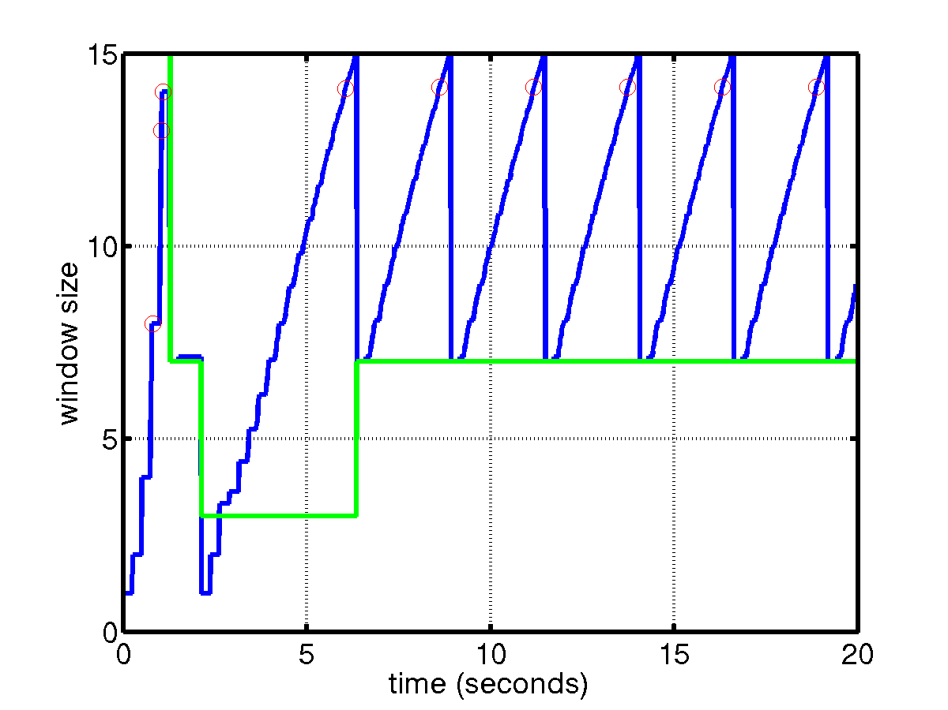
TCP Reno (Jacobson 1990)
SS
CA
Fast retransmission/fast recovery

Slide 43
Slow Start
Start with cwnd = 1 (slow start)
On each successful ACK increment cwnd
cwnd ← cnwd + 1
Exponential growth of cwnd
each RTT: cwnd ← 2 x cwnd
Enter CA when cwnd >= ssthresh

Slide 44
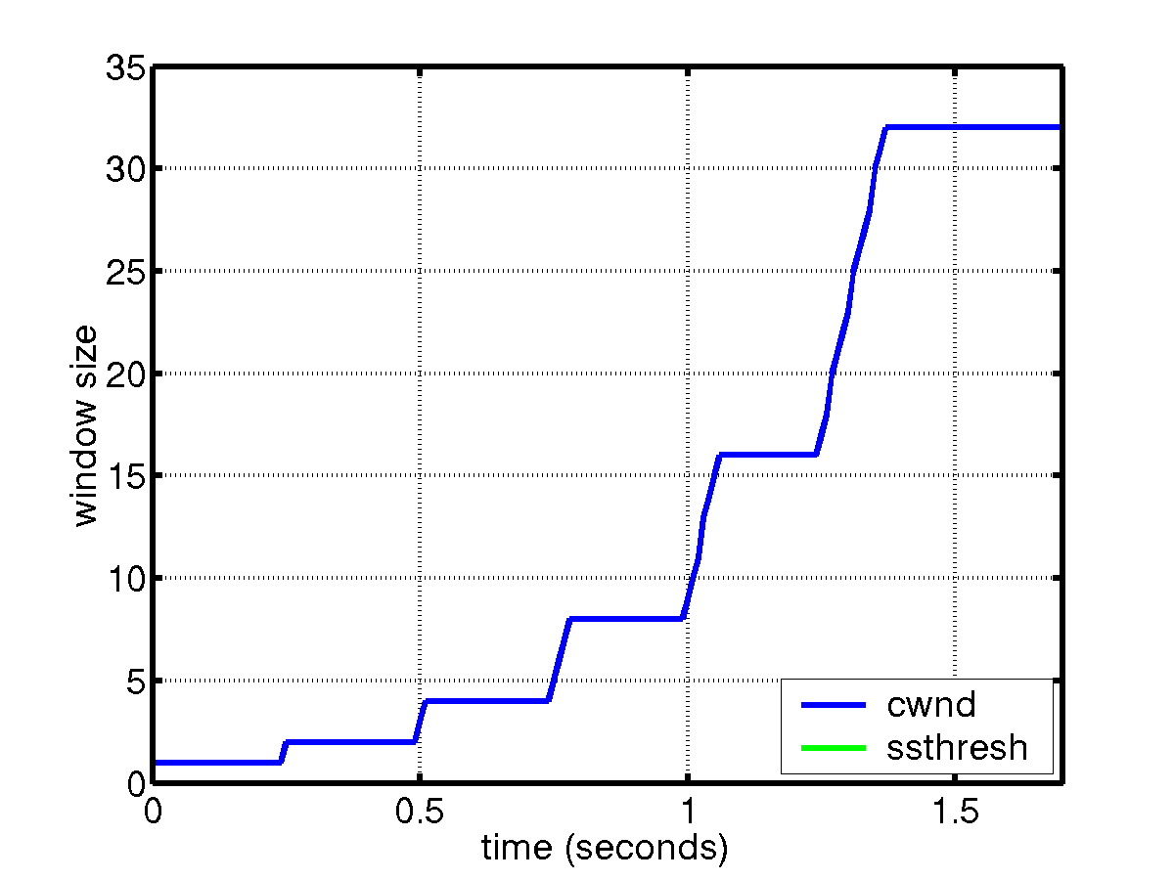
Slow Start
sender
receiver
cwnd
1
data packet
1 RTT
ACK
2
3
4
5
6
7
8
cwnd ← cwnd + 1 (for each ACK)

Slide 45
Congestion Avoidance
Starts when cwnd ≥ ssthresh
On each successful ACK:
cwnd ← cwnd + 1/cwnd
Linear growth of cwnd
each RTT: cwnd ← cwnd + 1

Slide 46
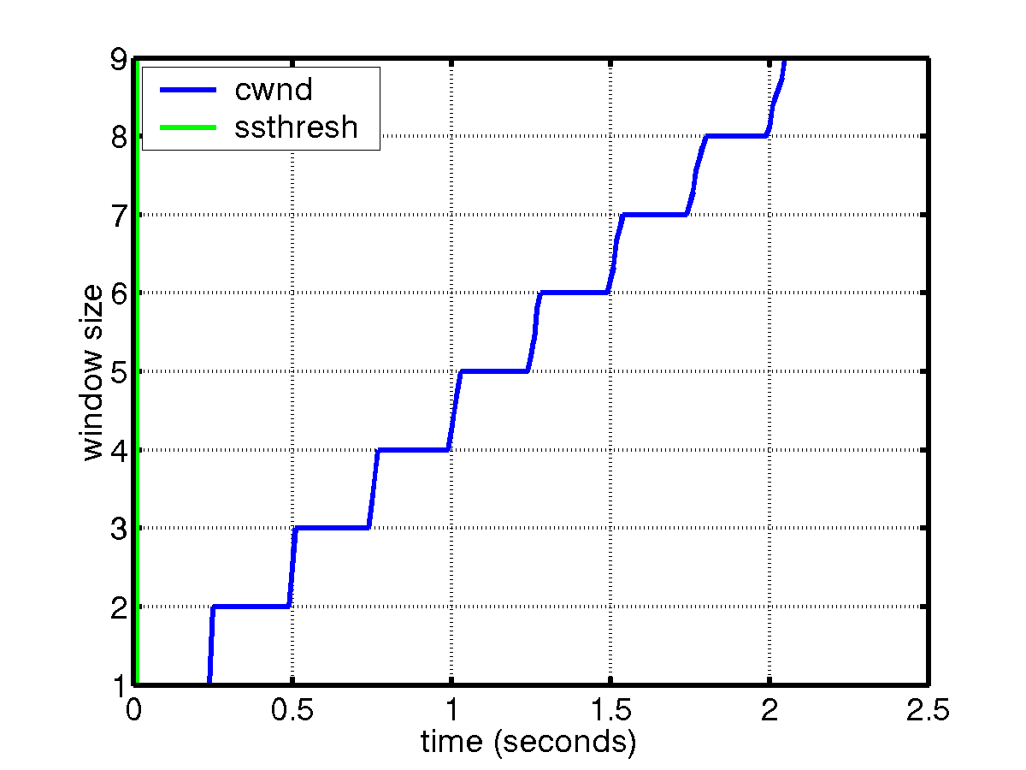
Congestion Avoidance
sender
receiver
cwnd
1
data packet
ACK
2
1 RTT
3
4
cwnd ← cwnd + 1 (for cwnd worth of ACKs)

Slide 47
Packet Loss
Assumption: loss indicates congestion
Packet loss detected by
Retransmission TimeOuts (RTO timer)
Duplicate ACKs (at least 3)
Packets
1
2
3
4
5
6
7
Acknowledgements
1
2
3
3
3
3

Slide 48
Fast Retransmit/Fast Recovery
Motivation
Waiting for timeout is too long
Prevent `pipe’ from emptying during recovery
Idea
3 dupACKs indicate packet loss
Each dupACK also indicates a packet having left the pipe (successfully received)!
Notes:
After FR/FR, when CA is entered, cwnd is half of the window when lost was detected.
So the effect of lost is halving the window.
[Source: RFC 2581, Fall & Floyd, “Simulation based Comparison of Tahoe, Reno, and SACK TCP”]

Slide 49
Fast Retransmit/Fast Recovery
Enter FR/FR after 3 dupACKs
Set ssthresh ← max(flightsize/2, 2)
Retransmit lost packet
Set cwnd ← ssthresh + ndup (window inflation)
Wait till W=min(awnd, cwnd) is large enough; transmit new packet(s)
On non-dup ACK (1 RTT later), set cwnd ← ssthresh (window deflation)
Enter CA (unless timeout)
Notes:
After FR/FR, when CA is entered, cwnd is half of the window when lost was detected.
So the effect of lost is halving the window.
[Source: RFC 2581, Fall & Floyd, “Simulation based Comparison of Tahoe, Reno, and SACK TCP”]

Slide 50
Example: FR/FR
RTT
S
1
2
3
4
5
6
7
8
1
9
0
1
time
Exit FR/FR
D
1
1
1
1
1
1
1
8
time
window inflation
7
9
11
4
window deflates
Fast retransmit
Retransmit on 3 dupACKs
Fast recovery
Inflate window while repairing loss to fill pipe

Slide 51
Summary: Reno
Basic idea
AIMD probes available bandwidth
Fast recovery avoids slow start
dupACKs: fast retransmit + fast recovery
Timeout: fast retransmit + slow start
dupACKs
congestion avoidance
FR/FR
timeout
slow start
retransmit

Slide 52
TCP CC variants
Differ mainly in Congestion Avoidance
Vegas: delay-based
FAST: delay-based, scalable
CUBIC: time since last congestion
CTCP: use both loss & delay
dupACKs
congestion avoidance
FR/FR
timeout
slow start
retransmit

Slide 53
Congestion avoidance
Reno
for every ACK {
W += 1/W (AI)
}
for every loss {
W = W/2 (MD)
}
Jacobson
1988
Vegas
for every ACK {
if W/RTT_{min} – W/RTT < α then W ++
if W/RTT_{min} – W/RTT > β then W --
}
for every loss {
W = W/2
}
Brakmo
Peterson
1995

Slide 54
Congestion avoidance
FAST
periodically
{
}
Jin, Wei, Low
2004

Slide 55
Congestion control protocols
Why congestion control?
Where is CC implemented?
Window control mechanism
CC protocols and basic structure
Active queue management (AQM)

Slide 56
Feedback control
p_{l}(t)
x_{i}(t)
Example congestion measure p_{l}(t)
Loss (Reno)
Queueing delay (Vegas)

Slide 57
TCP/AQM
p_{l}(t)
AQM:
DropTail
RED
REM/PI
AVQ
TCP:
Reno
Vegas
FAST
x_{i}(t)
Congestion control is a distributed asynchronous algorithm to share bandwidth
It has two components
TCP: adapts sending rate (window) to congestion
AQM: adjusts & feeds back congestion information
They form a distributed feedback control system
Equilibrium & stability depends on both TCP and AQM
And on delay, capacity, routing, #connections

Slide 58
Implicit feedback
Drop-tail
FIFO queue
Drop packet that arrives at a full buffer
Implicit feedback
Queueing process implicitly computes and feeds back congestion measure
Delay: simple dynamics
Loss: no convenient model

Slide 59
Active queue management
Explicit feedback
Provide congestion information by probabilistically marking packets
2 ECN bit in IP header allocated for AQM
Supported by all new routers but usually turned off in the field

Slide 60
RED (Floyd & Jacobson 1993)
Congestion measure: average queue length
b_{l}(t+1) = [b_{l}(t) + y_{l}(t) - c_{l}]⁺
r_{l}(t+1) = (1-α) r_{l}(t) + α b_{l}(t)
Embedding: p-linear probability function
Feedback: dropping or ECN marking
marking
1
Avg queue

Slide 61
REM (Athuraliya & Low 2000)
Congestion measure: price
b_{l}(t+1) = [b_{l}(t) + y_{l}(t) - c_{l}]⁺
p_{l}(t+1) = [p_{l}(t) + γ(α_{l} b_{l}(t)+ x^{l} (t) - c_{l} )]⁺
Embedding: exponential probability function
Feedback: dropping or ECN marking

Slide 62
REM
Clear buffer and match rate
Clear buffer
Match rate
Sum prices
Theorem (Paganini 2000)
Global asymptotic stability for general utility function (in the absence of delay)

Slide 63
Summary: CC protocols
End-to-end CC implemented in TCP
Basic window mechanism
TCP performs connection setup, error recovery, and congestion control,
CC dynamically computes cwnd that limits max #pkts enroute
Distributed feedback control algorithm
TCP: adapts congestion window
AQM: adapts congestion measure
Notes:
After FR/FR, when CA is entered, cwnd is half of the window when lost was detected.
So the effect of lost is halving the window.
[Source: RFC 2581, Fall & Floyd, “Simulation based Comparison of Tahoe, Reno, and SACK TCP”]

Slide 64
Agenda
9:00 Congestion control protocols
10:00 break
10:15 Mathematical models
11:15 break
11:30 Advanced topics
12:30 lunch

Slide 65
Mathematical Models

Slide 66
Mathematical models
Why mathematical models?
Dynamical systems model of CC
Convex optimization primer
Reverse engr: equilibrium properties
Forward engr: FAST TCP

Slide 67
Why mathematical models
Protocols are critical, yet difficult, to understand and optimize
Local algorithms, distributed spatially and vertically → global behavior
Designed separately, deployed asynchronously, evolves independently
application
transport
network
link
physical

Slide 68
Why mathematical models
application
transport
network
link
physical
Need systematic way to understand, design, and optimize
Their interactions
Resultant global behavior

Slide 69
Why mathematical models
Not to replace intuitions, expts, heuristics
Provides structure and clarity
Refines intuition
Guides design
Suggests ideas
Explores boundaries
Understands structural properties
Risk
“All models are wrong”
“… some are useful”
Validate with simulations & experiments

Slide 70
Structural properties
Equilibrium properties
Throughput, delay, loss, fairness
Dynamic properties
Stability
Robustness
Responsiveness
Scalability properties
Information scaling (decentralization)
Computation scaling
Performance scaling

Slide 71
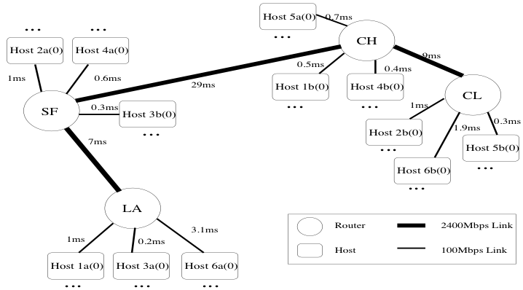
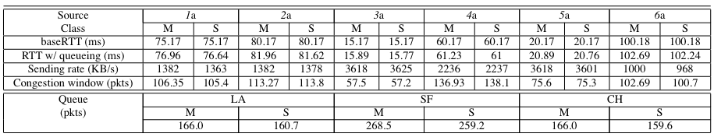
L., Peterson, Wang, JACM 2002
Notes:
Before ~2000, no one in the world can predict the throughputs of a set of TCP flows sharing a simple network (that’s more than a single bottleneck), despite a decade of research. With the theory developed in the last decade or so, we can now predict the throughput, delay, loss in an arbitrary TCP network (under appropriate assumptions). Here is one example.

Slide 72
Limitations of basic model
Static and deterministic network
Fixed set of flows, link capacities, routing
Real networks are time-varying and random
Homogeneous protocols
All flows use the same congestion measure
Fluid approximation
Ignore packet level effects, e.g. burstiness
Inaccurate buffering process
Difficulty in analysis of model
Global stability in presence of feedback delay
Robustness, responsiveness
basic model has been generalized
to address these issues to various degrees

Slide 73
Mathematical models
Why mathematical models?
Dynamical systems model of CC
Convex optimization primer
Reverse engr: equilibrium properties
Forward engr: FAST TCP

Slide 74
TCP/AQM
p_{l}(t)
AQM:
DropTail
RED
REM/PI
AVQ
TCP:
Reno
Vegas
FAST
x_{i}(t)
Congestion control is a distributed asynchronous algorithm to share bandwidth
It has two components
TCP: adapts sending rate (window) to congestion
AQM: adjusts & feeds back congestion information
They form a distributed feedback control system
Equilibrium & stability depends on both TCP and AQM
And on delay, capacity, routing, #connections

Slide 75
Network model
Network
Links l of capacities c_{l} and congestion measure p_{l}(t)
Sources i
Source rates x_{i}(t)
Routing matrix R
x₁(t)
p₁(t)
p₂(t)
x₂(t)
x₃(t)

Slide 76
Network model
x
y
R
F₁
G₁
TCP
Network
AQM
F_{N}
G_{L}
q
p
R^{T}
IP routing
TCP CC model consists of
specs for F_{i} and G_{l}
Reno, Vegas
Droptail, RED

Slide 77
Examples
Derive (F_{i}, G_{l}) model for
Reno/RED
Vegas/Droptail
FAST/Droptail
Focus on Congestion Avoidance

Slide 78
Model: Reno
for every ack (ca)
{ W += 1/W }
for every loss
{ W := W/2 }

Slide 79
Model: Reno
for every ack (ca)
{ W += 1/W }
for every loss
{ W := W/2 }
throughput
window size
round-trip
loss probability
link loss
probability

Slide 80
Model: Reno
for every ack (ca)
{ W += 1/W }
for every loss
{ W := W/2 }

Slide 81
Model: RED
marking prob
1
aggregate
link rate
source
rate
queue length

Slide 82
Model: Reno/RED

Slide 83
Decentralization structure
x
y
y
R
F₁
G₁
TCP
Network
AQM
F_{N}
G_{L}
q
q
p
R^{T}

Slide 84
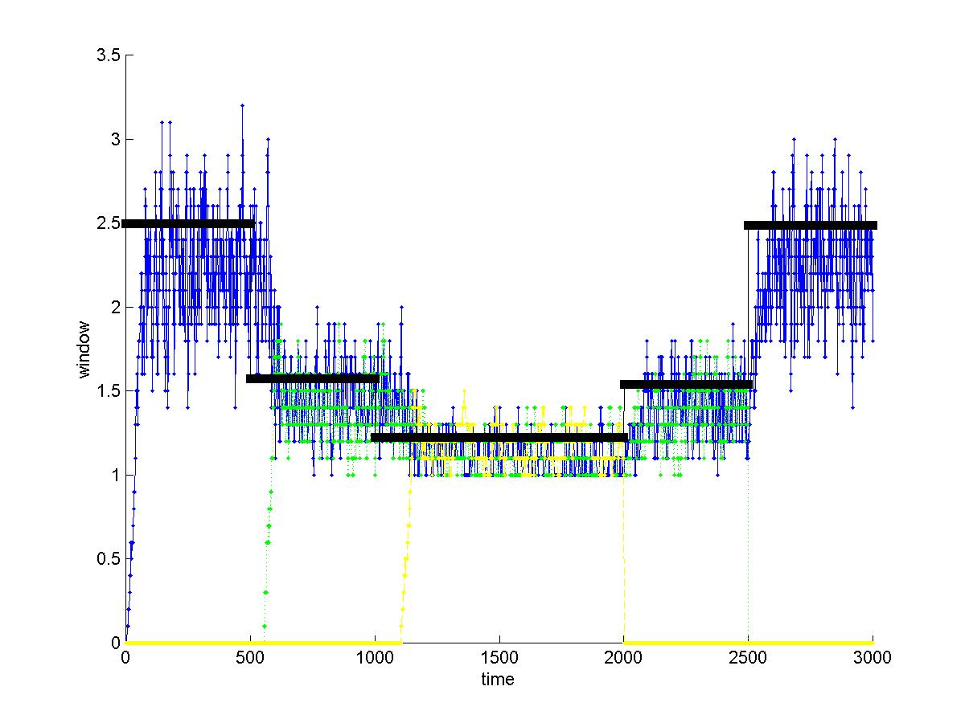
Validation – Reno/REM
30 sources, 3 groups with RTT = 3, 5, 7 ms
Link capacity = 64 Mbps, buffer = 50 kB
Smaller window due to small RTT (~0 queueing delay)
Notes:
Same scenario as Reno
3 groups of 10 sources each, with RTT (propagation delay + queueing, from measurement) 9, 11 & 13 ms.
Group 1 starts at time 0, group 2 starts at time 500, and group 3 starts at time 1000.
Graph shows the mean window process, averaged over the 10 sources of each group.
Window is in unit of packets, each of size 1kBytes.
Note
Windows are equalized, independent of RTTs
Measured windows match well with those predicted by the model
Note: Individual windows were halved on each decrement, but the graph shows the window process averaged over 10 sources in each group.

Slide 85
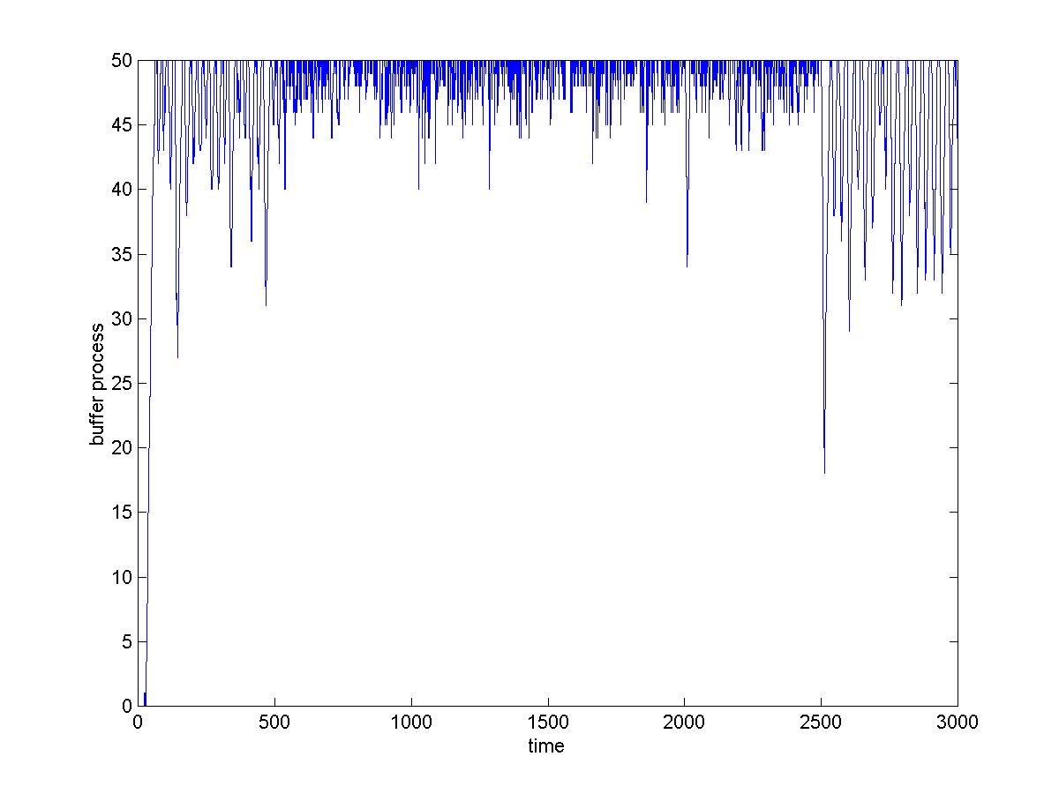
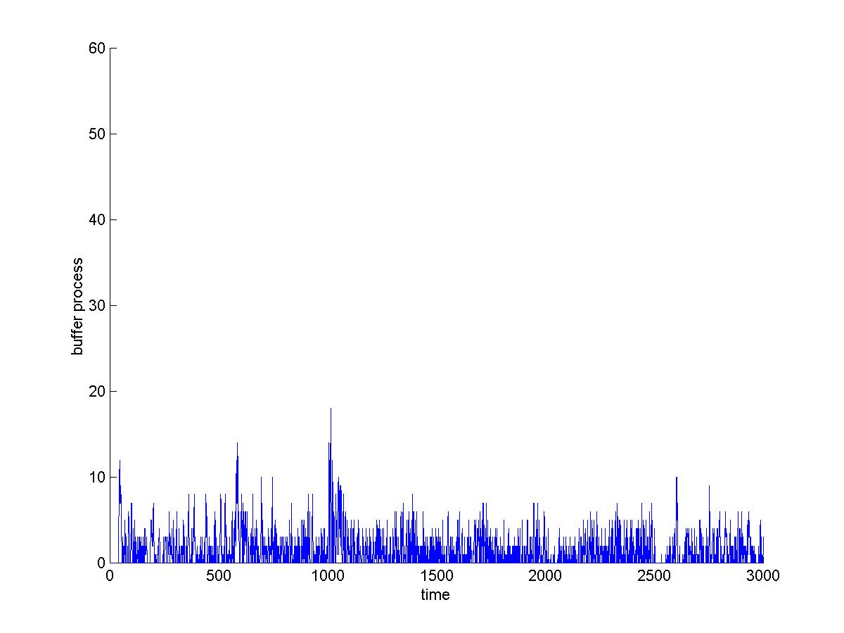
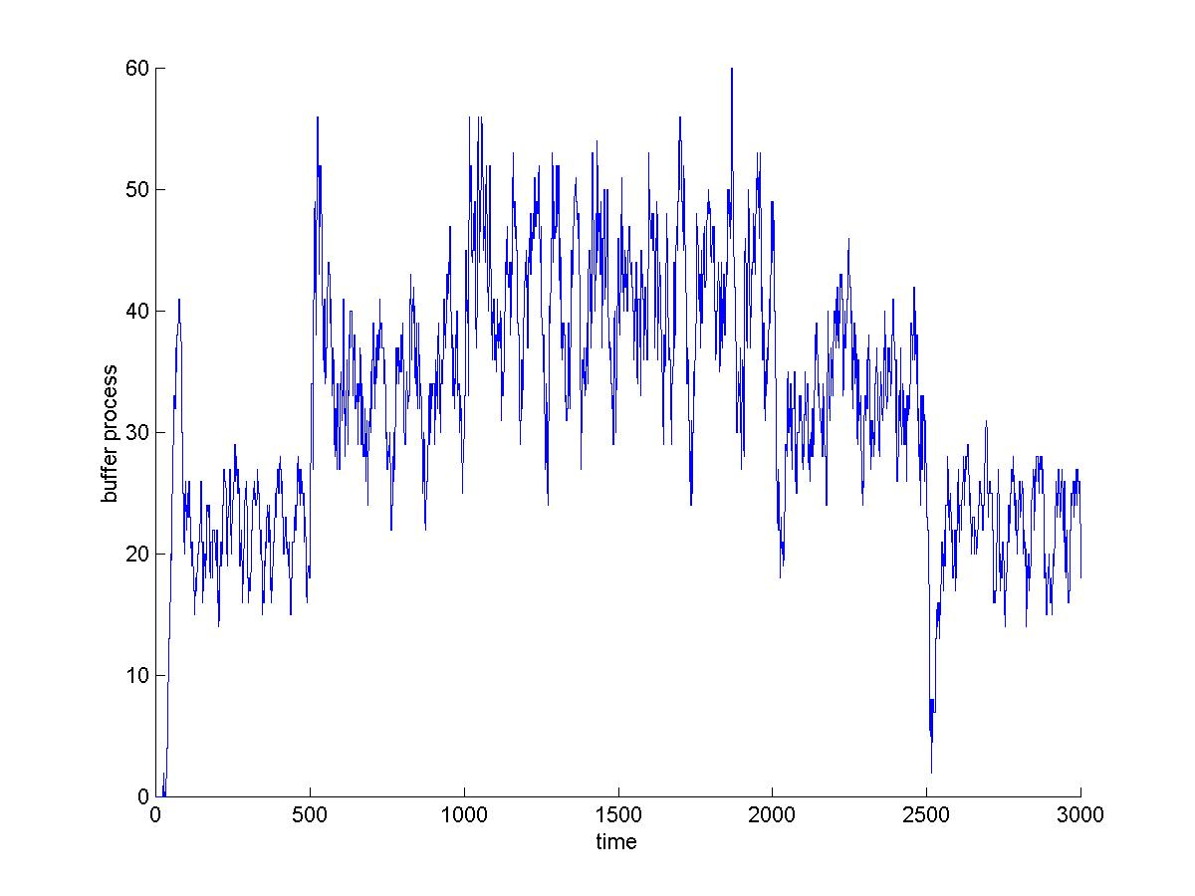
Queue
REM
queue = 1.5 pkts
utilization = 92%
γ = 0.05, α = 0.4, φ = 1.15
p = Lagrange multiplier!
DropTail
queue = 94%
p decoupled from queue
RED
min_th = 10 pkts
max_th = 40 pkts
max_p = 0.1
p increasing in queue!
Notes:
30 sources, 3 groups with RTT = 3, 5, 7ms + 6ms (queueing delay) Link capacity = 64 Mbps, buffer = 50 kB
3 groups of 10 sources each, with RTT (propagation delay + queueing, from measurement) 9, 11 & 13 ms.
Group 1 starts at time 0, group 2 starts at time 500, and group 3 starts at time 1000.
Graph shows the mean window process, averaged over the 10 sources of each group.
Window is in unit of packets, each of size 1kBytes.
Note
Windows are equalized, independent of RTTs
Measured windows match well with those predicted by the model
Note: Individual windows were halved on each decrement, but the graph shows the window process averaged over 10 sources in each group.

Slide 86
Model: Vegas/Droptail
for every RTT
{ if W/RTT_{min} – W/RTT < α then W ++
if W/RTT_{min} – W/RTT > α then W -- }
for every loss
W := W/2
queue size
F_{i}:
G_{l}:
p_{l}(t+1) = [p_{l}(t) + y_{l} (t)/c_{l} - 1]⁺

Slide 87
Model: FAST/Droptail
periodically
{
}

Slide 88
L., Peterson, Wang, JACM 2002
Notes:
Before ~2000, no one in the world can predict the throughputs of a set of TCP flows sharing a simple network (that’s more than a single bottleneck), despite a decade of research. With the theory developed in the last decade or so, we can now predict the throughput, delay, loss in an arbitrary TCP network (under appropriate assumptions). Here is one example.

Slide 89
Validation: matching transients
[Jacobsson et al 2009]
Same RTT, no cross traffic
Same RTT, cross traffic
Different RTTs, no cross traffic

Slide 90
Recap
Protocol (Reno, Vegas, FAST, Droptail, RED…)
Equilibrium
Performance
Throughput, loss, delay
Fairness
Utility
Dynamics
Local stability
Global stability

Slide 91
Mathematical models
Why mathematical models?
Dynamical systems model of CC
Convex optimization primer
Reverse engr: equilibrium properties
Forward engr: FAST TCP

Slide 92
Background: optimization
Called convex program if U_{i} are concave functions

Slide 93
Background: optimization
Called convex program if U_{i} are concave functions
Local optimum is globally optimal
First order optimality (KKT) condition is necessary and sufficient
Convex programs are polynomial-time solvable
Whereas nonconvex programs are generally NP hard

Slide 94
Background: optimization
Theorem
Optimal solution x* exists
It is unique if U_{i} are strictly concave
strictly concave
not

Slide 95
Background: optimization
Theorem
x* is optimal if and only if there exists such that
Lagrange
multiplier
Complementary
slackness: all
bottlenecks are
fully utilized

Slide 96
Background: optimization
Theorem
p* can be interpreted as prices
Optimal maximizes its own benefit
incentive compatible

Slide 97
Background: optimization
Theorem
Gradient decent algorithm to solve the dual problem is decentralized
law of supply & demand

Slide 98
Background: optimization
Theorem
Gradient decent algorithm to solve the dual problem is decentralized
Gradient-like algorithm to solve NUM
defines TCP CC algorithm !
reverse/forward
engineer TCP

Slide 99
Mathematical models
Why mathematical models?
Dynamical systems model of CC
Convex optimization primer
Reverse engr: equilibrium properties
Forward engr: FAST TCP

Slide 100
Duality model of TCP/AQM
TCP/AQM
Equilibrium (x*,p*) primal-dual optimal:
F determines utility function U
G guarantees complementary slackness
p* are Lagrange multipliers
Kelly, Maloo, Tan 1998
Low, Lapsley 1999
Uniqueness of equilibrium
x* is unique when U is strictly concave
p* is unique when R has full row rank

Slide 101
Duality model of TCP/AQM
TCP/AQM
Equilibrium (x*,p*) primal-dual optimal:
F determines utility function U
G guarantees complementary slackness
p* are Lagrange multipliers
Kelly, Maloo, Tan 1998
Low, Lapsley 1999
The underlying convex program also
leads to simple dynamic behavior

Slide 102
Duality model of TCP/AQM
Equilibrium (x*,p*) primal-dual optimal:
Mo & Walrand 2000:
α = 1 : Vegas, FAST, STCP
α = 1.2: HSTCP
α = 2 : Reno
α = : XCP (single link only)
Low 2003

Slide 103
Duality model of TCP/AQM
Equilibrium (x*,p*) primal-dual optimal:
Mo & Walrand 2000:
α = 0: maximum throughput
α = 1: proportional fairness
α = 2: min delay fairness
α = : maxmin fairness
Low 2003

Slide 104
Some implications
Equilibrium
Always exists, unique if R is full rank
Bandwidth allocation independent of AQM or arrival
Can predict macroscopic behavior of large scale networks
Counter-intuitive throughput behavior
Fair allocation is not always inefficient
Increasing link capacities do not always raise aggregate throughput
[Tang, Wang, Low, ToN 2006]
Forward engineering: FAST TCP
Design, analysis, experiments
[Wei, Jin, Low, Hegde, ToN 2006]

Slide 105
Equilibrium throughput
α = 1.225 (Reno), 0.120 (HSTCP)
Reno penalizes long flows
Reno’s square-root-p throughput formula
Vegas, FAST: equilibrium cond = Little’s Law

Slide 106
Vegas/FAST: effect of RTT error
Persistent congestion can arise due to
Error in propagation delay estimation
Consequences
Excessive backlog
Unfairness to older sources
Theorem
A relative error of ε_{s} in propagation delay estimation distorts the utility function to

Slide 107
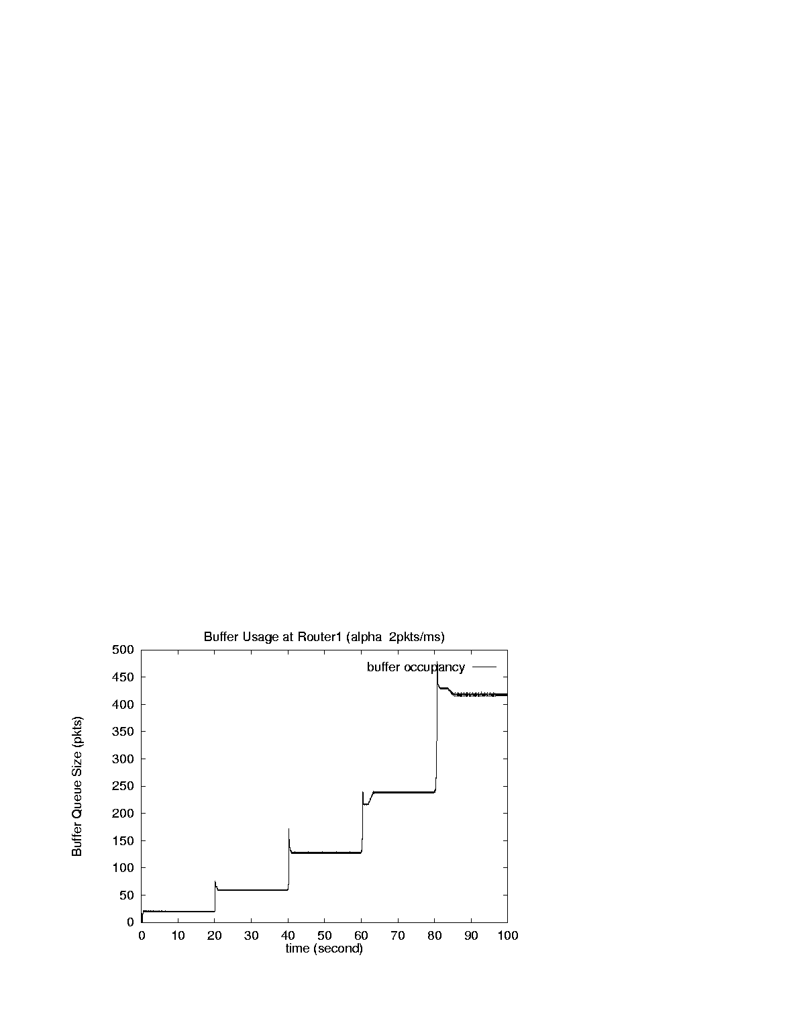
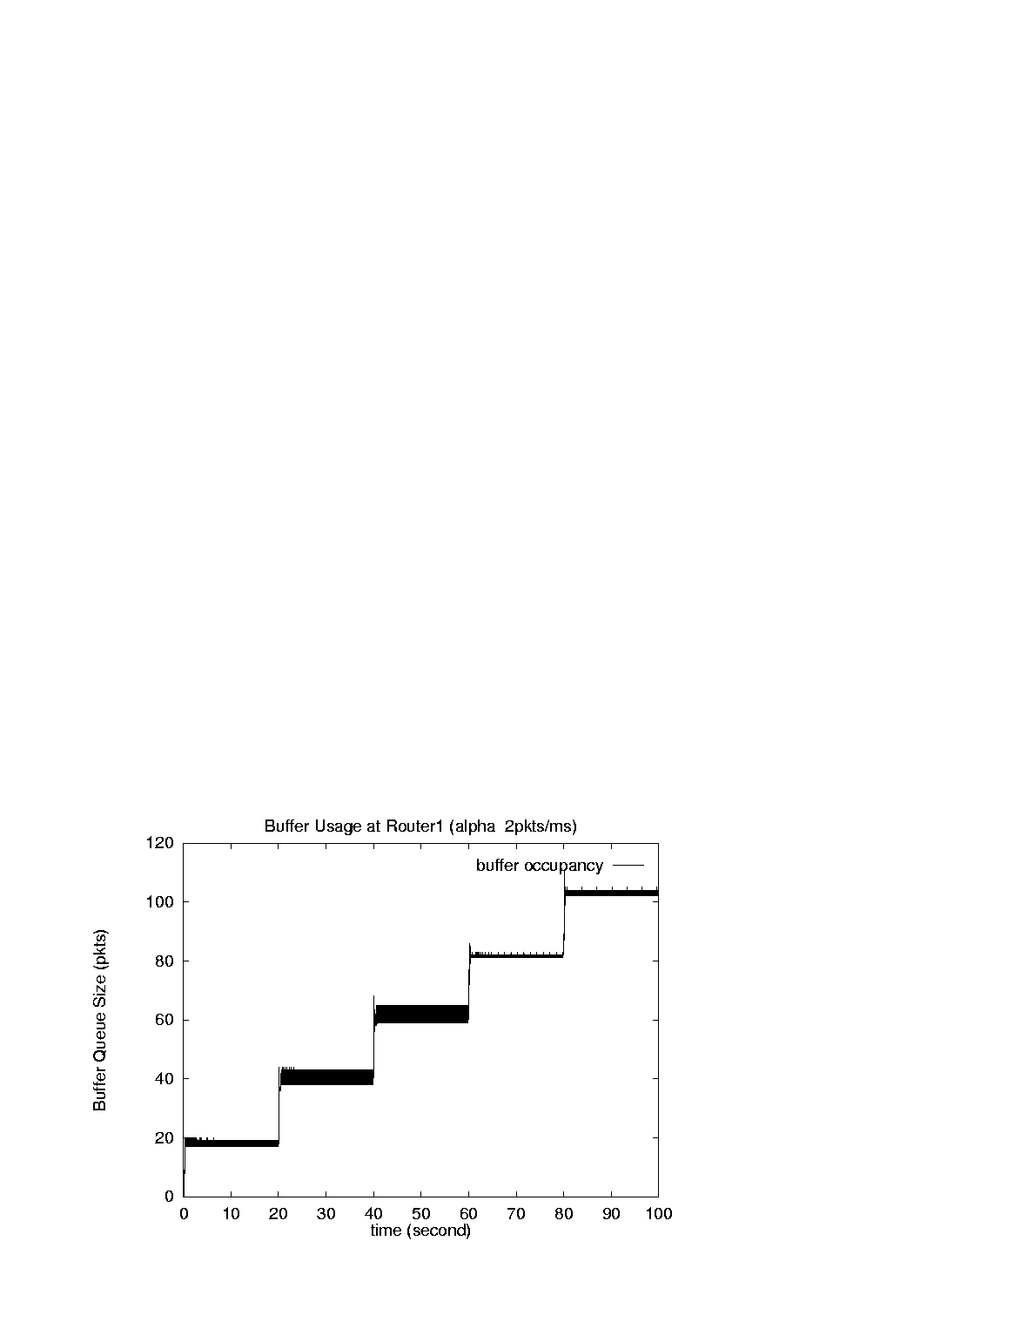
Evalidation
Without estimation error
With estimation error
Single link, capacity = 6 pkt/ms, α_{s} = 2 pkts/ms, d_{s} = 10 ms
With finite buffer: Vegas reverts to Reno

Slide 108
Validation
Source rates (pkts/ms)
# src1 src2 src3 src4 src5
5.98 (6)
2.05 (2) 3.92 (4)
0.96 (0.94) 1.46 (1.49) 3.54 (3.57)
0.51 (0.50) 0.72 (0.73) 1.34 (1.35) 3.38 (3.39)
0.29 (0.29) 0.40 (0.40) 0.68 (0.67) 1.30 (1.30) 3.28 (3.34)
# queue (pkts) baseRTT (ms)
19.8 (20) 10.18 (10.18)
59.0 (60) 13.36 (13.51)
127.3 (127) 20.17 (20.28)
237.5 (238) 31.50 (31.50)
416.3 (416) 49.86 (49.80)

Slide 109
Mathematical models
Why mathematical models?
Dynamical systems model of CC
Convex optimization primer
Reverse engr: equilibrium properties
Forward engr: FAST TCP

Slide 110
Reno design
Reno TCP
Packet level
ACK: W ← W + 1/W
Loss: W ← W – 0.5W
Flow level
Equilibrium
Dynamics
pkts
(Mathis formula 1996)

Slide 111
Reno design
Packet level
Designed and implemented first
Flow level
Understood afterwards
Flow level dynamics determines
Equilibrium: performance, fairness
Stability
Design flow level equilibrium & stability
Implement flow level goals at packet level

Slide 112
Forward engineering
Decide congestion measure
Loss, delay, both
Design flow level equilibrium properties
Throughput, loss, delay, fairness
Analyze stability and other dynamic properties
Control theory, simulate, improve model/algorithm
Iterate 1 – 3 until satisfactory
Simulate, prototype, experiment
Compare with theoretical predictions
Improve model, algorithm, code
Iterate 1 – 5 until satisfactory

Slide 113
Forward engineering
Tight integration of theory, design, experiment
Performance analysis done at design time
Not after
Theory does not replace intuitions and heuristics
Refines, validates/invalidates them
Theory provides structure and clarity
Guides design
Suggests ideas and experiments
Explores boundaries that are hard to expt

Slide 114
Packet level description
Reno
AIMD(1, 0.5)
ACK: W ← W + 1/W
Loss: W ← W – 0.5W
HSTCP
AIMD(a(w), b(w))
ACK: W ← W + a(w)/W
Loss: W ← W – b(w)W
ACK: W ← W + 0.01
Loss: W ← W – 0.125W
STCP
MIMD(a, b)
FAST

Slide 115
Flow level: Reno, HSTCP, STCP, FAST
Common flow level dynamics!
window
adjustment
=
control
gain
flow level
goal
Different gain κ and utility U_{i}
They determine equilibrium and stability
Different congestion measure q_{i}
Loss probability (Reno, HSTCP, STCP)
Queueing delay (Vegas, FAST)

Slide 116
Flow level: Reno, HSTCP, STCP, FAST
Common flow level dynamics!
window
adjustment
=
control
gain
flow level
goal
Small adjustment when close, large far away
Need to estimate how far current state is wrt target
Scalable
Reno, Vegas: window adjustment independent of q_{i}
Depends only on current window
Difficult to scale

Slide 117




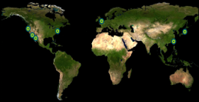

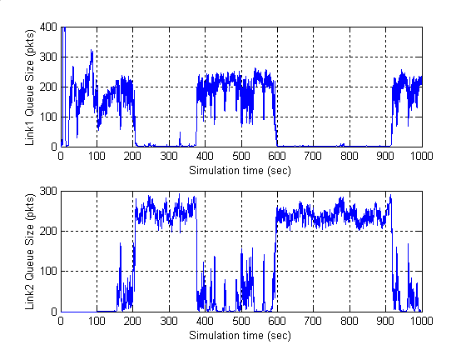
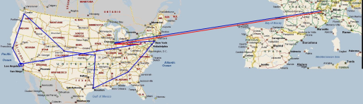




















rsrg
NetLab
prof steven low
Lee Center
SISL
Caltech FAST Project
control & optimization of networks
2000
2001
2002
2003
2004
2005
2006
2007
theory
experiment
Lee Center
FAST TCP theory
IPAM Wkp
WAN-in-Lab Testbed
testbed
deployment
SC02 Demo
Collaborators: Doyle (Caltech), Newman (Caltech), Paganini (Uruguay), Tang (Cornell), Andrew (Swinburne), Chiang (Princeton); CACR, CERN, Internet2, SLAC, Fermi Lab, StarLight, Cisco
theory
testbed
experiment
deployment
Internet: largest distributed nonlinear feedback control system
WAN-in-Lab : one-of-a-kind wind- tunnel in academic networking, with 2,400km of fiber, optical switches, routers, servers, accelerators
Scientists have used FastTCP to break world records on data transfer between 2002 – 2006
FAST is commercialized by FastSoft; it accelerates world’s 2nd largest CDN and Fortune 100 companies
Reverse engineering: TCP is real-time distributed algorithm over Internet to maximize utility
TCP
FastTCP
eq 2
eq 3
SC 2004
Internet
eq 1
Internet2 LSR
SuperComputing BC
FAST in a box
Forward engineering: Invention of FastTCP based on control theory & convex optimization
with FAST
without FAST

Slide 118
Some benefits
Transparent interaction among components
TCP, AQM
Clear understanding of structural properties
Understanding effect of parameters
Change protocol parameters, topology, routing, link capacity, set of flows
Re-solve NUM
Systematic way to tune parameters

Slide 119
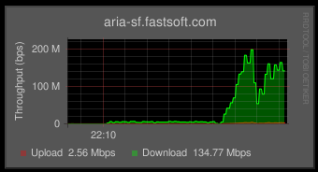
Extreme resilience to loss
Without FAST
throughput: 1Mbps
With FAST
throughput: 120Mbps
Heavy packet loss in Sprint network:
FAST TCP increased throughput by 120x !
SF → New York
June 3, 2007

Slide 120
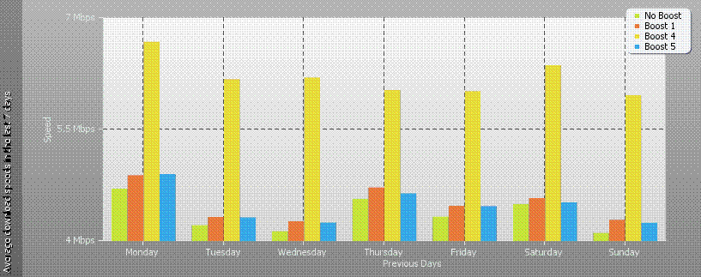
10G appliance customer data
Average download speed 8/24 – 30, 2009, CDN customer (10G appliance)
FAST vs TCP stacks in BSD, Windows, Linux

Slide 121
Summary: math models
Integration of theory, design, experiment can be very powerful
Each needs the other
Combination much more than sum
Theory-guided design approach
Tremendous progress in the last decade; not as impossible as most feared
Very difficult; but worth the effort
Most critical: mindset
How to push theory-guided design approach further ?
Notes:
After FR/FR, when CA is entered, cwnd is half of the window when lost was detected.
So the effect of lost is halving the window.
[Source: RFC 2581, Fall & Floyd, “Simulation based Comparison of Tahoe, Reno, and SACK TCP”]

Slide 122
Agenda
9:00 Congestion control protocols
10:00 break
10:15 Mathematical models
11:15 break
11:30 Advanced topics
12:30 lunch

Slide 123
Advanced Topics

Slide 124
Advanced topics
Heterogeneous protocols
Layering as optimization decomposition

Slide 125
The world is heterogeneous…
Linux 2.6.13 allows users to choose congestion control algorithms
Many protocol proposals
Loss-based: Reno and a large number of variants
Delay-based: CARD (1989), DUAL (1992), Vegas (1995), FAST (2004), …
ECN: RED (1993), REM (2001), PI (2002), AVQ (2003), …
Explicit feedback: MaxNet (2002), XCP (2002), RCP (2005), …

Slide 126
Some implications
 | homogeneous | heterogeneous
equilibrium | unique | ?
bandwidth allocation on AQM | independent | ?
bandwidth allocation on arrival | independent | ?

Slide 127
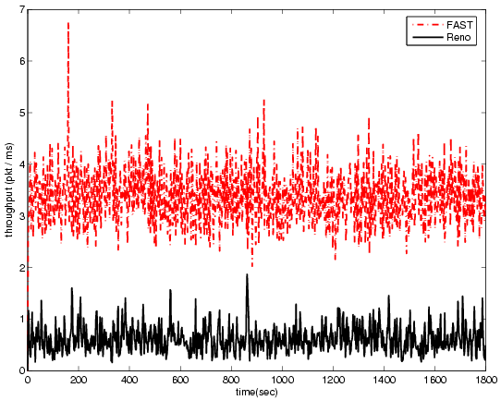
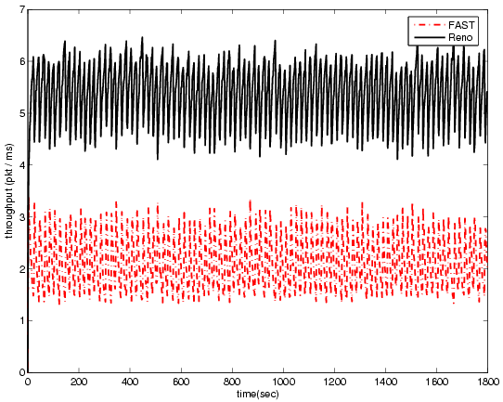
Throughputs depend on AQM
FAST throughput
buffer size = 80 pkts
buffer size = 400 pkts
FAST and Reno share a single bottleneck router
NS2 simulation
Router: DropTail with variable buffer size
With 10% heavy-tailed noise traffic

Slide 128
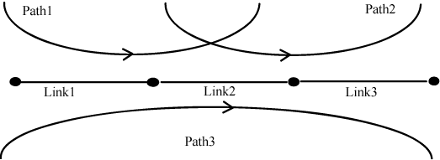
Multiple equilibria: throughput depends on arrival
Dummynet experiment
eq 2
 | eq 1 | eq 2
Path 1 | 52M | 13M
path 2 | 61M | 13M
path 3 | 27M | 93M
eq 1
Tang, Wang, Hegde, Low, Telecom Systems, 2005

Slide 129
Multiple equilibria: throughput depends on arrival
Dummynet experiment
eq 2
eq 3 (unstable)
 | eq 1 | eq 2
Path 1 | 52M | 13M
path 2 | 61M | 13M
path 3 | 27M | 93M
eq 1
Tang, Wang, Hegde, Low, Telecom Systems, 2005

Slide 130
Duality model:
Why can’t use F_{i}’s of FAST and Reno in duality model?
They use different prices!
delay for FAST
loss for Reno

Slide 131
Duality model:
Why can’t use F_{i}’s of FAST and Reno in duality model?
They use different prices!

Slide 132
Homogeneous protocol
x
y
R
F₁
G₁
TCP
Network
AQM
F_{N}
G_{L}
q
p
R^{T}
same price
for all sources

Slide 133
Heterogeneous protocol
x
y
R
F₁
G₁
TCP
Network
AQM
F_{N}
G_{L}
q
p
R^{T}
heterogeneous
prices for
type j sources

Slide 134
Heterogeneous protocols
Equilibrium: p that satisfies
Duality model no longer applies !
p_{l} can no longer serve as Lagrange multiplier

Slide 135
Heterogeneous protocols
Equilibrium: p that satisfies
Need to re-examine all issues
Equilibrium: exists? unique? efficient? fair?
Dynamics: stable? limit cycle? chaotic?
Practical networks: typical behavior? design guidelines?

Slide 136
Notation
Simpler notation: p is equilibrium if
on bottleneck links
Jacobian:
Linearized dual algorithm:
Tang, Wang, L., Chiang, ToN, 2007
Tang, Wei, L., Chiang, ToN, 2010

Slide 137
Existence
Theorem
Equilibrium p exists, despite lack of underlying utility maximization
Generally non-unique
There are networks with unique bottleneck set but infinitely many equilibria
There are networks with multiple bottleneck set each with a unique (but distinct) equilibrium

Slide 138
Regular networks
Definition
A regular network is a tuple (R, c, m, U) for
which all equilibria p are locally unique, i.e.,
Theorem
Almost all networks are regular
A regular network has finitely many and odd number of equilibria (e.g. 1)

Slide 139
Global uniqueness
Theorem
If price heterogeneity is small, then equilibrium is globally unique
Implication
a network of RED routers with slope inversely proportional to link capacity almost always has globally unique equilibrium

Slide 140
Local stability
Theorem
If price heterogeneity is small, then the unique equilibrium p is locally stable
If all equilibria p are locally stable, then it is globally unique
Linearized dual algorithm:
Equilibrium p is locally stable if

Slide 141
Summary
 | homogeneous | heterogeneous
equilibrium | unique | non-unique
bandwidth allocation on AQM | independent | dependent
bandwidth allocation on arrival | independent | dependent
Interesting characterizations of equilibrium …
But not much understanding on dynamics

Slide 142
Efficiency
Result
Every equilibrium p* is Pareto efficient
Proof:
Every equilibrium p* yields a (unique) rate x(p*) that solves

Slide 143
Efficiency
Result
Every equilibrium p* is Pareto efficient
Measure of optimality
Achieved:

Slide 144
Efficiency
Result
Every equilibrium p* is Pareto efficient
Loss of optimality:
Measure of optimality
Achieved:

Slide 145
Efficiency
Result
Every equilibrium p* is Pareto efficient
Loss of optimality:
e.g. A network of RED routers with default parameters suffers no loss of optimality

Slide 146
Intra-protocol fairness
Result
Fairness among flows within each type is unaffected, i.e., still determined by their utility functions and Kelly’s problem with reduced link capacities
Proof idea:
Each equilibrium p chooses a partition of link capacities among types, c^{j}:= c^{j}(p)
Rates x^{j}(p) then solve

Slide 147
Inter-protocol fairness
Theorem
Any fairness is achievable with a linear scaling of utility functions

Slide 148
Inter-protocol fairness
Theorem
Any fairness is achievable with a linear scaling of utility functions
i.e. given any x in X, there exists μ s.t. an equilibrium p has x(p) = x

Slide 149
Slow timescale control
Slow timescale scaling of utility function
scaling of end--to-end price
slow timescale update of scaling factor

Slide 150
ns2 simulation: buffer=80pks
FAST throughput
without slow timescale control
with slow timescale control

Slide 151
ns2 simulation: buffer=400pks
FAST throughput
without slow timescale control
with slow timescale control

Slide 152
Advanced topics
Heterogeneous protocols
Layering as optimization decomposition

Slide 153
The Internet hourglass
Applications
Web
Search
Mail
News
Video
Audio
Friends
TCP
IP
Ethernet
802.11
3G/4G
ATM
Optical
Satellite
Bluetooth
Link technologies

Slide 154
But what is architecture
“Architecture involves or facilitates
System-level function (beyond components)
Organization and structure
Protocols and modules
Risk mitigation, performance, evolution
but is more than the sum of these”
“… the architecture of a system defines how the system is broken into parts and how those parts interact.”
-- John Doyle, Caltech
-- Clark, Sollins, Wroclawski, …, MIT

Slide 155
But what is architecture
“Things that persist over time”
“Things that are common across networks”
“Forms that enable functions”
“Frozen but evolves”
“It is intrinsic but artificial”
Key features (John Doyle, Caltech)
Layering as optimization decomposition
Constraints that deconstrain
Robust yet fragile

Slide 156
Layering as opt decomposition
Each layer designed separately and evolves asynchronously
Each layer optimizes certain objectives
application
transport
network
link
physical
Minimize response time (web layout)…
Maximize utility (TCP/AQM)
Minimize path costs (IP)
Reliability, channel access, …
Minimize SIR, max capacities, …
Notes:
Network adopts a layered architecture. As a result, protocol stack for network has five layers: application, transport, network, link and physical layers. Each layer is designed separately and usually abstracted as an optimization problem. For example, TCP can be seen as a distributed algorithm to solve utility maximization problem, intradomain routing is to solve minimum cost problem. The main reason to choose a layered structure is to manage the design complexity. This has been justified by the success of communication network.

Slide 157
Layering as opt decomposition
Each layer is abstracted as an optimization problem
Operation of a layer is a distributed solution
Results of one problem (layer) are parameters of others
Operate at different timescales
Application: utility
application
transport
network
link
physical
Phy: power
IP: routing
Link: scheduling

Slide 158
Layering as opt decomposition
Each layer is abstracted as an optimization problem
Operation of a layer is a distributed solution
Results of one problem (layer) are parameters of others
Operate at different timescales
1) Understand each layer in isolation, assuming
other layers are designed nearly optimally
2) Understand interactions across layers
3) Incorporate additional layers
4) Ultimate goal: entire protocol stack as
solving one giant optimization problem, where
individual layers are solving parts of it
application
transport
network
link
physical

Slide 159
Layering as opt decomposition
Network generalized NUM
Layers subproblems
Layering decomposition methods
Interface functions of primal or dual vars
1) Understand each layer in isolation, assuming
other layers are designed nearly optimally
2) Understand interactions across layers
3) Incorporate additional layers
4) Ultimate goal: entire protocol stack as
solving one giant optimization problem, where
individual layers are solving parts of it
application
transport
network
link
physical

Slide 160
Examples
Optimal web layer: Zhu, Yu, Doyle ’01
HTTP/TCP: Chang, Liu ’04
application
transport
network
link
physical
TCP: Kelly, Maulloo, Tan ’98, ……
TCP/IP: Wang et al ’05, ……
TCP/MAC: Chen et al ’05, ……
TCP/power control: Xiao et al ’01,
Chiang ’04, ……
Rate control/routing/scheduling: Eryilmax et al ’05, Lin et al ’05, Neely, et al ’05, Stolyar ’05, Chen, et al ’05
detailed survey in Proc. of IEEE, 2006

Slide 161
Example: dual decomposition
Design via dual decomposition
Congestion control, routing, scheduling/MAC
As distributed gradient algorithm to jointly solve NUM
Provides
basic structure of key algorithms
framework to aid protocol design
Ref:
Cross-layer design in multihop wireless networks Lijun Chen, Steven H. Low and John C. Doyle. Computer Networks Journal, Special Issue on Wireless for the Future Internet, 2010

Slide 162
Wireless mesh network
s
i
j
d

Slide 163
Wireless mesh network
Underlying optimization problem:
Utility to flows (s,d)
Cost of using links (i,j)
Local flow constraint
Schedulability constraint

Slide 164
Dual decomposition
utility function U_{i}^{d}
congestion control
local congestion price
p_{i}^{d}
transmission rate
x_{i}^{d}
routing
neighbor congestion prices
p_{j}^{d}, λ_{ij}^{d}
output queue d*
to service
link weights w_{ij}
price = queueing delay
scheduling
links (i,j) to
transmit
conflict graph

Slide 165
Algorithm architecture
Security Mgt
Application
utility
local price
Congestion Control
queue
length
Routing
En/Dequeue
d*
other
nodes
weights
conflict
graph
Estimation
Scheduling/MAC
Xmit/Rcv
Topology Control
Radio Mgt
Physical Xmission
Mobility Management

